Slide 1

Assertive Discipline – Data Entry, Validation, and Correction Workshop
Department of Technology Services

Slide 2

Basic Webinar Training Guidelines
Put phone on mute to eliminate outside noises
Do not put the call on hold
One conversation at a time – please allow each participant to speak
Un-mute the phone temporarily to ask a question
Please avoid multi-tasking, if possible

Slide 3

Agenda
General:
  Updating Aeries which Updates CALPADS
  Discipline Data Submission
  Best Practices
No, No’s…
  Manual Entry
  Modification of Incident ID#s
Use of the Incident ID number
Blank Records
Blank Disposition(s)
Linking multiple Students involved in the SAME incident
Linking of perpetrator to Victims and/or Witnesses form
Use of the Victims and/or Witnesses form
SSA Date Alert
Use of the Weapon Type field

Slide 4
Updating Aeries which Updates CALPADS
Update Aeries with Assertive Discipline data throughout the Academic Year (AY)
July 1, 2013 – June 30, 2014
Update CALPADS with EOY records throughout the Academic Year (AY)
July 1, 2013 – June 30, 2014
Any student enrolled during the Academic Year will be counted

Slide 5
Discipline Data Submission
When?
  School Districts MUST report at the end of the school year, any and all students in the following categories:
Who?
  All non Special Education K-12 students who were suspended (in or out of school for at least one entire school day) or expelled due to the commission of a student offense (per Ed Code sections 48900 & 48915) at any time during the reporting period
  All Special Ed students who committed a student offense regardless of the action taken (Disposition)
  All students who committed a firearm offense (Aeries Codes 1, 5, 8, 9, 11, 38,39, 40, 41, 42, and 79), regardless of the action taken (Disposition)

Slide 6
Best Practices
These data should be maintained in Aeries throughout the year as the incidents occur
The data will be monitored for maintenance and corrections
Schools are responsible for the entry of student discipline data into Aeries
Schools are responsible for correcting student discipline data in Aeries
Schools are responsible for reviewing and approving CALPADS reports prior to EOY 3 – Discipline data certification

Slide 7
No, No’s…
Manual Entry of Incident ID numbers
Modifications of Incident ID numbers
  Incident ID Numbers are auto-assigned in Aeries
  Incident ID Numbers are 6 digit numbers
  Incident ID Numbers are unique to each school site
  5 digit Incident ID numbers are manual errors
Entry into the Old Disposition in ADS
How to Correct 5 digit Incident ID numbers:
  Delete the 5 digits from the field
  Enter a zero
  Press the Tab key
  Next available number will be auto-assigned

Slide 8
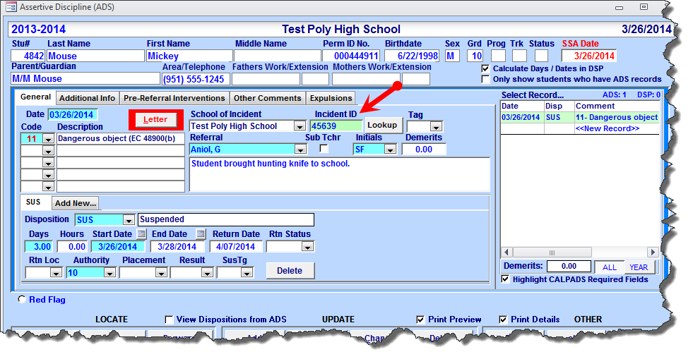
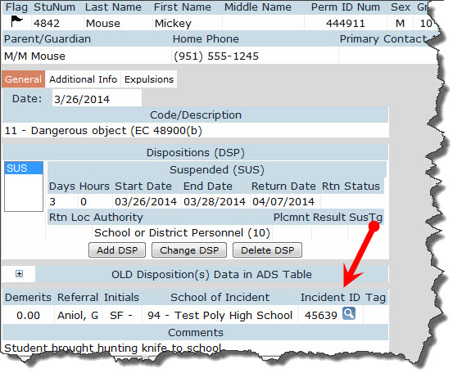
Manual Entry/Modification of the Incident ID Number
Aeries CS
Aeries NET

Slide 9
Use of the Incident ID Number
Incident ID Numbers CAN have more than 1 disposition
  Scenario: Student is assigned Detention but does not show up. The next Disposition (action taken) since the student was a no show for detention, is Saturday School.
  Solution: Add a New Disposition to the existing Discipline record. DO NOT CREATE a new Discipline record.
Creating a brand new Discipline record will generate an error
How to Correct the Incidents:
  Find the original (first) entry in the Assertive Discipline table
  Add the additional Discipline Code
  Select the Add New tab and input the new Disposition
  Add additional comments if necessary
  Delete the duplicate Discipline record

Slide 10
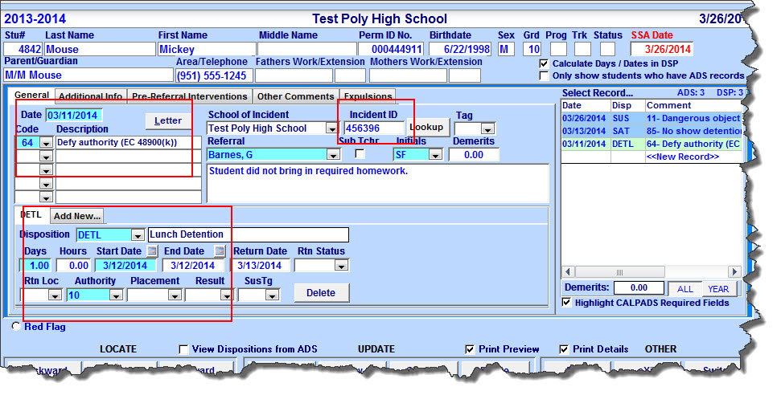
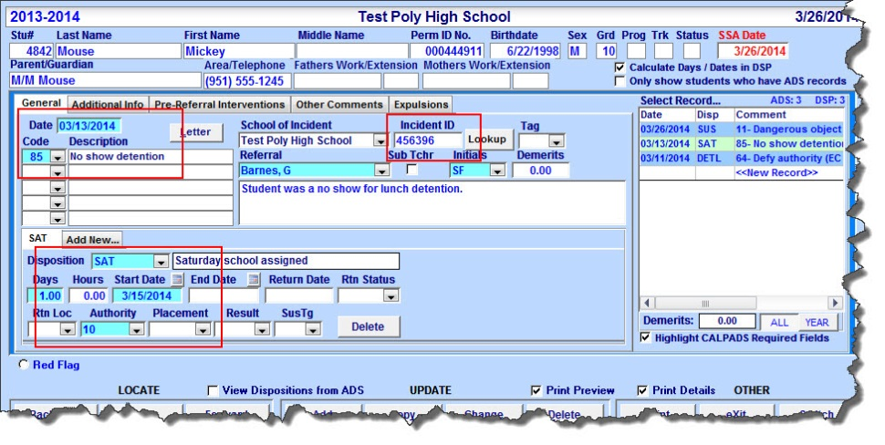
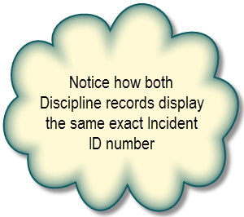
Multiple Assertive Discipline Records – Same Incident ID (Aeries CS)

Slide 11
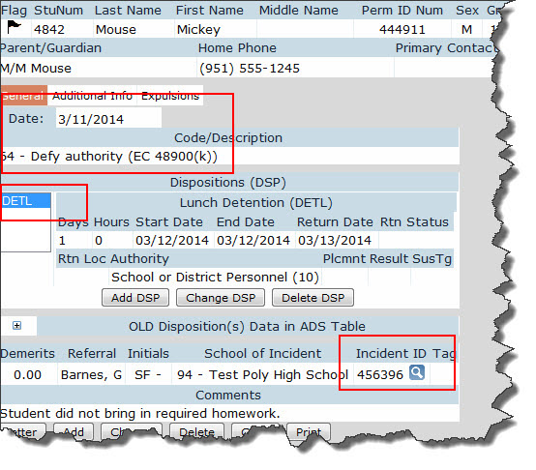
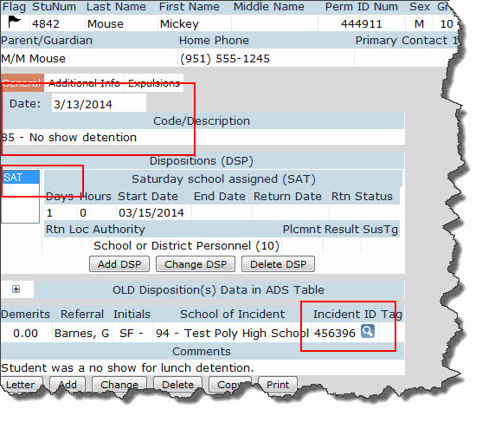
Multiple Assertive Discipline Records – Same Incident ID (Aeries NET)

Slide 12
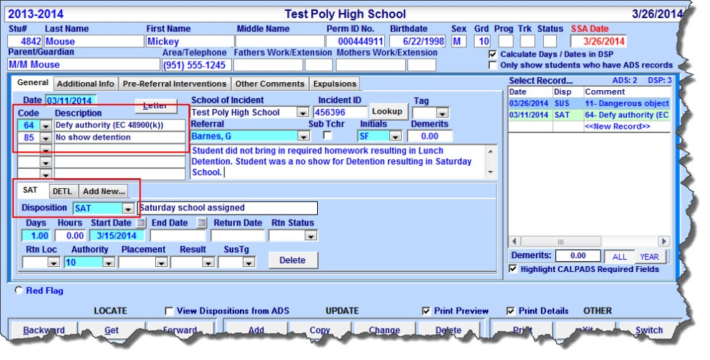
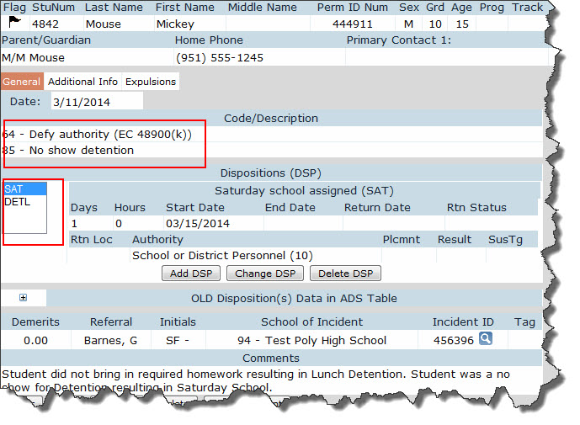
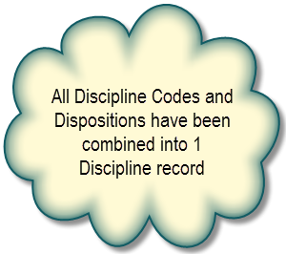
What it Should Look Like…
Aeries CS
Aeries NET

Slide 13

Blank Records
Blank records can be deleted via Aeries CS or Aeries.NET
Blank records can only be created through Aeries.NET
Blank records generate errors
Blank records must be deleted
  Select the blank record in the Assertive Discipline table
  Click the Delete button at the bottom of the form

Slide 14
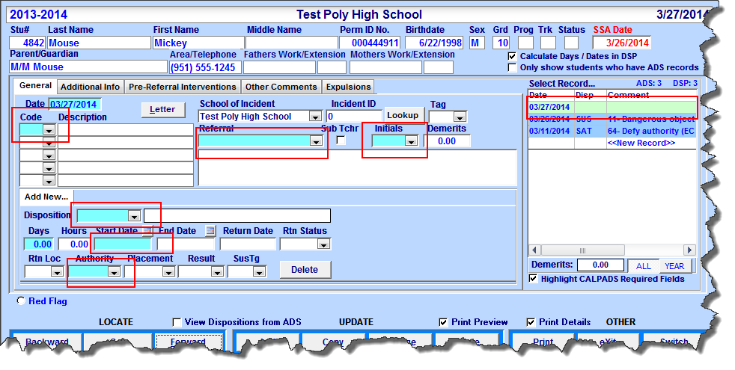
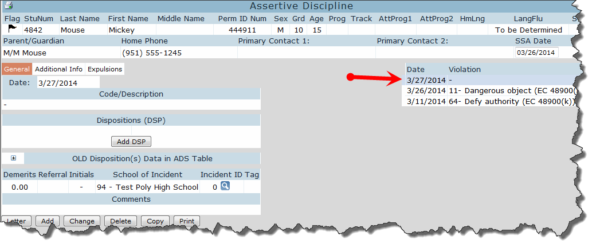
Blank Records in Aeries
Aeries CS
Aeries NET

Slide 15
Blank Dispositions
Each Assertive Discipline record MUST have 1 or more Dispositions to accompany the record
Blank Dispositions generate errors
To locate Assertive Discipline records with missing Disposition(s) (be sure to include Inactive Students)
LIST STU ADS DSP STU.ID STU.LN STU.FN STU.GR ADS.DT ADS.CD DSP.DS DSP.DD IF DSP.DS = " " AND ADS.DT > 06/30/2013
To fix the error in Aeries CS:
  Select the Assertive Discipline record
  Add Disposition on the Add New tab at the bottom of the form, populate all mandatory fields
To fix the error in Aeries.NET:
  Select the Assertive Discipline record
  Click on Add DSP
  Add Disposition and populate all mandatory fields

Slide 16
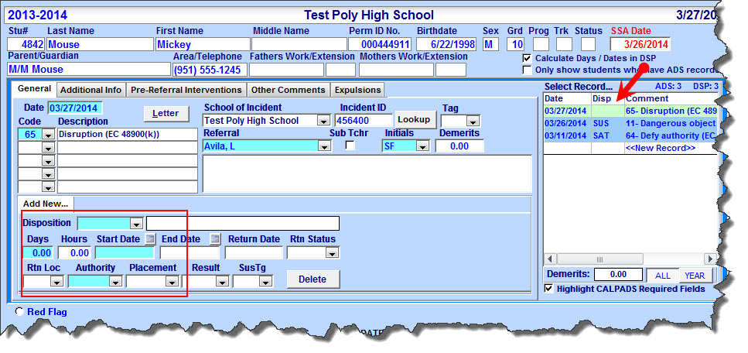
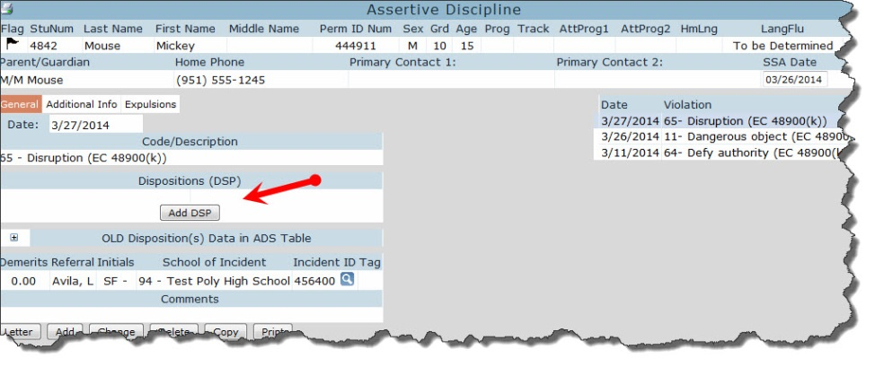
Blank Dispositions in Aeries
Aeries CS
Aeries NET

Slide 17
Multiple Students Involved in the Same Incident
Two or more students that are involved in the SAME incident MUST have the same Incident ID number
Scenario A:
  Two students involved in a mutual fight should be linked with the same Incident ID number
Scenario B:
  A group of 10 students who were caught smoking should all share the same Incident ID number

Slide 18
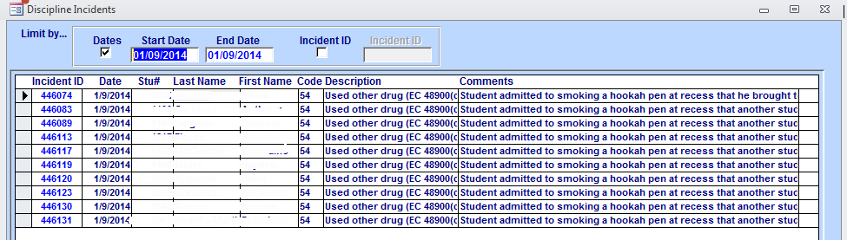
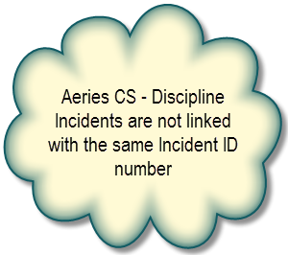
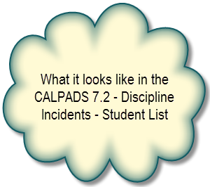
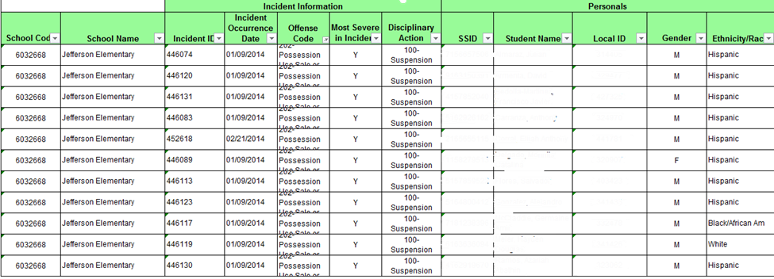
The Effects of Not Linking Incident ID Numbers

Slide 19
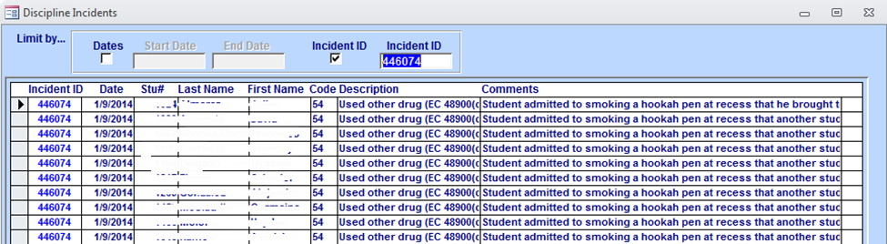
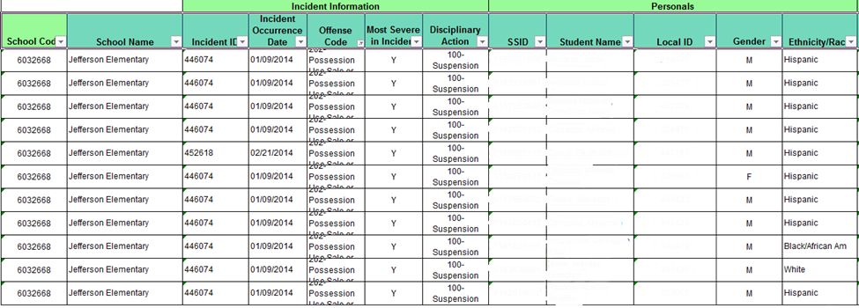
When The Students Are Linked…

Slide 20
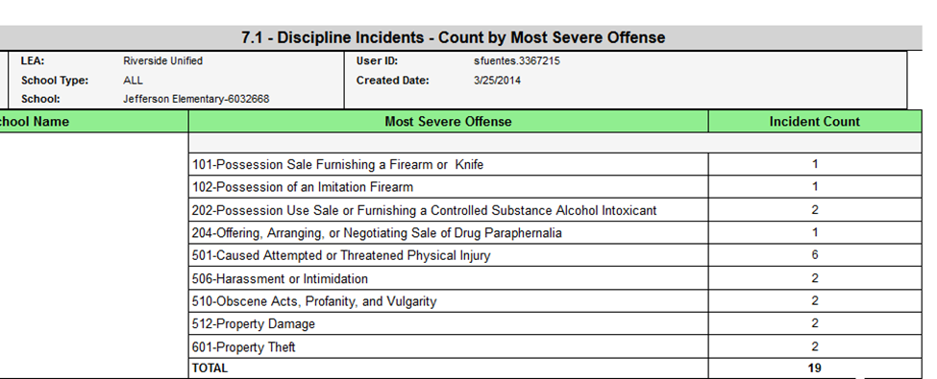
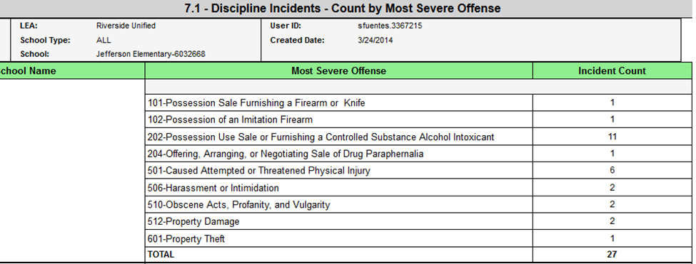
Before and After Linking…
Before
After

Slide 21
Victims and Witnesses Form
  All schools MUST use the Victims and/or Witnesses form in Aeries
  This data is required for the Civil Right Data Collection – Federal reporting
The Victims and/or Witnesses form is used to document students who were the Victim of or a Witness to an incident
If a student is a Victim or a Witness to an incident documented in the Assertive Discipline table, then the Victims and/or Witnesses form MUST be linked with the perpetrators Assertive Discipline record using the same Incident ID number
The Victims and/or Witnesses form can be found under View All Forms

Slide 22
The Importance of the SSA Date
The SSA Date is automatically updated as soon as a Discipline Code is entered that falls under the 48900 Ed Code (excluding subdivision h or Section 48900.2, 48900.3, 48900.4 or 48900.7)
Discipline Codes that are entered/selected in error and later corrected, the SSA Date does not automatically revert to the previously populated date
Accuracy is of the utmost importance when entering Discipline Information

Slide 23
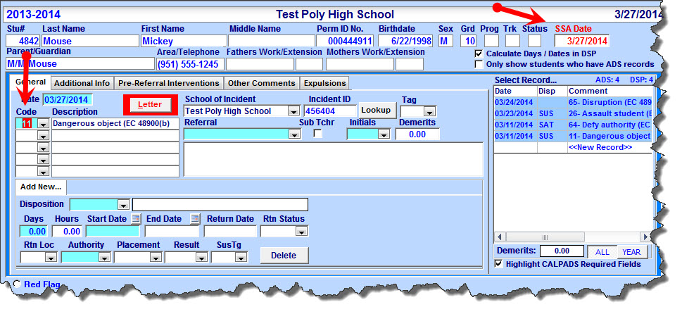
The Update of the SSA Date
Selecting a Discipline Code of 11 – Dangerous Object automatically updates the SSA Date to the date of the incident that is being entered
Removing or changing the Discipline Code does not update/change the SSA Date
If the Discipline Code was entered in error and the new Code is NOT a suspendable offense, then the SSA Date must be modified to the previous status
It is the schools responsibility to review the students Discipline History and repopulate the SSA Date with the correct date based on prior incident codes

Slide 24
Discipline Codes and the SSA Date
Discipline Codes MUST be entered by severity level
The SSA Date is updated based on the FIRST Discipline Code that is entered
For severity levels, refer to the RUSD Suspendable Offense Codes document
For further questions contact your sites CWA Manager
To locate students with 2 or more Discipline Codes (be sure to include inactive students)
LIST STU ADS DSP STU.NM STU.GR STU.ID ADS.IID ADS.CD ADS.CD2 ADS.DT DSP.DS IF ADS.CD > " " AND ADS.CD2 > " " AND ADS.DT >= "07/01/2013" AND ( DSP.DS = SUS OR DSP.DS = SUS-R OR DSP.DS = SSR )

Slide 25
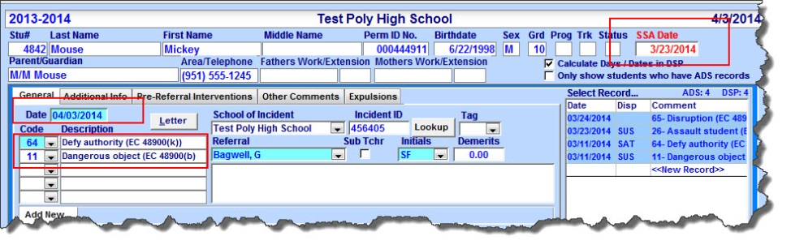
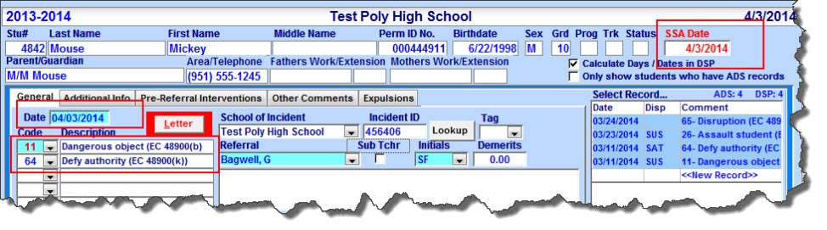
Discipline Codes and the SSA Date
Discipline Codes NOT in Order of Severity
Discipline Codes in Order of Severity

Slide 26
Weapon Type
When a student is disciplined for a Weapons related incident, the Weapon Type field MUST also be updated
The Weapon Type field is located in the Assertive Discipline table, under the Additional Info tab
Weapon related incidents include the following codes: 1, 5, 7, 8, 9, 11, 38, 39, 40, 41, 42, and 79

Slide 27
Department of Technology Services Help Desk Support & Training
General Support
  http://nisworks/
  (951)276-2002 (outside)
  81099 (VoIP)
DTS Support Training
  https://remote.rusd.k12.ca.us/TechnologyTraining/
Aeries Account Request Information
  http://ts.rusd.edu/
Aeries Student System Documentation
  http://ts.rusd.edu/

Slide 28
Questions?

